Slide 1
Cosmopolitan Empires of Sui and Tang
Chapter 5

Slide 2
The Northwest Military Aristocracy and the Sui Unification of China

Slide 3
The Sui (581-617)
524 AD Rebellion of the Six Garrisons
577 Northern Zhou reunified the North
Non-Chinese but fluid ethnicity (intermarriage)
581 AD Yang Jian usurps the Throne, proclaims the Sui
Kills 59 princes of Zhou Royal House
Known as Wendi (Cultured Emperor)
589 AD Sui Conquers Southern Kingdom, unifying China
Adopts policy of fusing local traditions
Uses three schools to legitimize reign
Marriage alliances reconciles Great Families

Slide 4
Sui Empire Building
Controlled Yangzi River
Drew on Buddhism to legitimize power
Had relics of Buddha distributed to temples
Reestablished Strong Central Government
Abolished Nine Rank System; used system of recommendation
Tier of local administration eliminated
Rule of Avoidance
Civil Service Examinations instituted to strike a blow against aristocracy and shore up imperial autocracy (see Video Lecture: China’s Examination Hell)

Slide 5
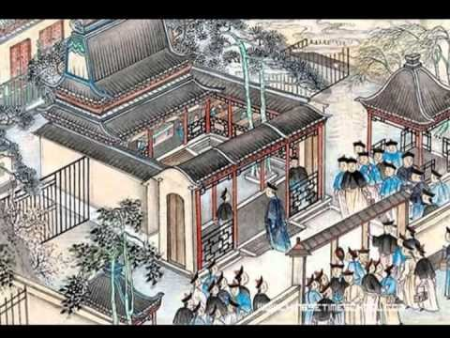
China’s Examination Hell
Notes:
21 min

Slide 6
Sui Empire Building
Controlled Yangzi River
Drew on Buddhism to legitimize power
Reestablished Strong Central Government
Significances:
Reduced power of officials and great families,
made officials more responsive to central government

Slide 7
Yangdi Emperor
604 – Yangdi assassinates his father; ascends the throne
Costly program of construction and conquest

Slide 8
Construction
Great Wall reconstructed
Grand Canal Dug
Huge Palaces

Slide 9
Conquest
Continues expansion of empire; wished to retake former Han territory

Slide 10
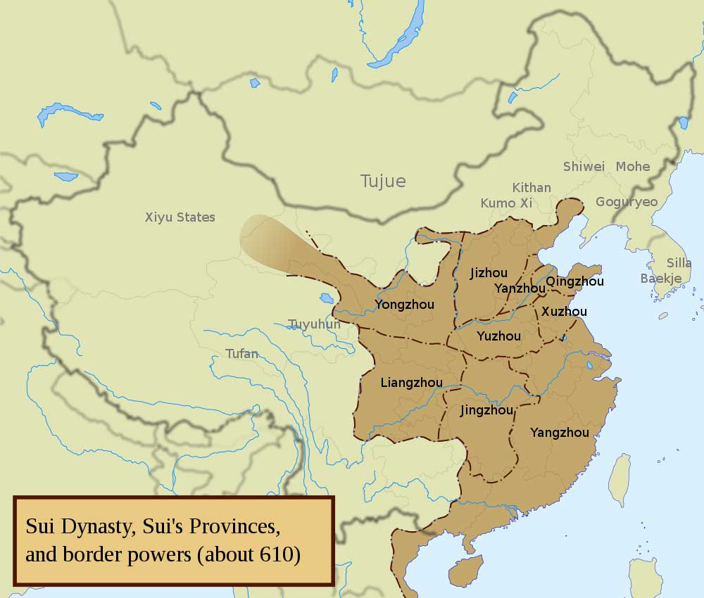
602 Hanoi falls to Sui; pushed South defeating the Champa war elephants
609 Sui Conquers N. Tibet
598-615 Sui sends troops to Koguryo
613-614 Sui retreats from Koguryo
615 Sui defeated by Eastern Turks

Slide 11
Collapse of the Sui
Major defeats cause a welter of rebellions
618 Yangdi escapes south, assassinated by a member of his own entourage
Traditional Interpretation – Dynastic Cycle
Yangdi as bad last emperor; lost mandate
Expansion placed strain on dynasty’s resources
Immiseration leads to insurrection and rebellion

Slide 12
The Founding of the Tang Dynasty
618-907

Slide 13
The Tang: Establishment and Consolidation
Li Yuan (Gaozu r. 618-626)
Sui General; related to Sui ruling house
Captures Ch’ang-an in 617
Following year proclaims the T’ang Dynasty
Usurpation – no sharp break in composition or policy of ruling group
626 Second son usurps throne, becomes Taizong

Slide 14
Consolidation
Broadened geographical composition of bureaucracy
Established granaries, schools and the Tang Code
Central government restructured
Drew on Buddhism, Daoism, and Confucianism
De-emphasized personal ritual in favor of public rites for good of all
Notes:
Taizong broadened the geographical composition of the bureaucracy by including men from areas other than his native northwest, but government remained in hands of well born.

Slide 15
T’ang Structure of Government

Slide 16
Tang Expansion (Pax Tang)
630 Resubjugate Eastern Turks
639-648 – Subjugate Uighur Turks
Tibet becomes Tang Suzerainty
Tang attacks Koguryo (northern Korean kingdom), but fails to conquer
Facilitates cross-cultural contact

Slide 17
The Tang at its Height

Slide 18
Chang-An

Slide 19
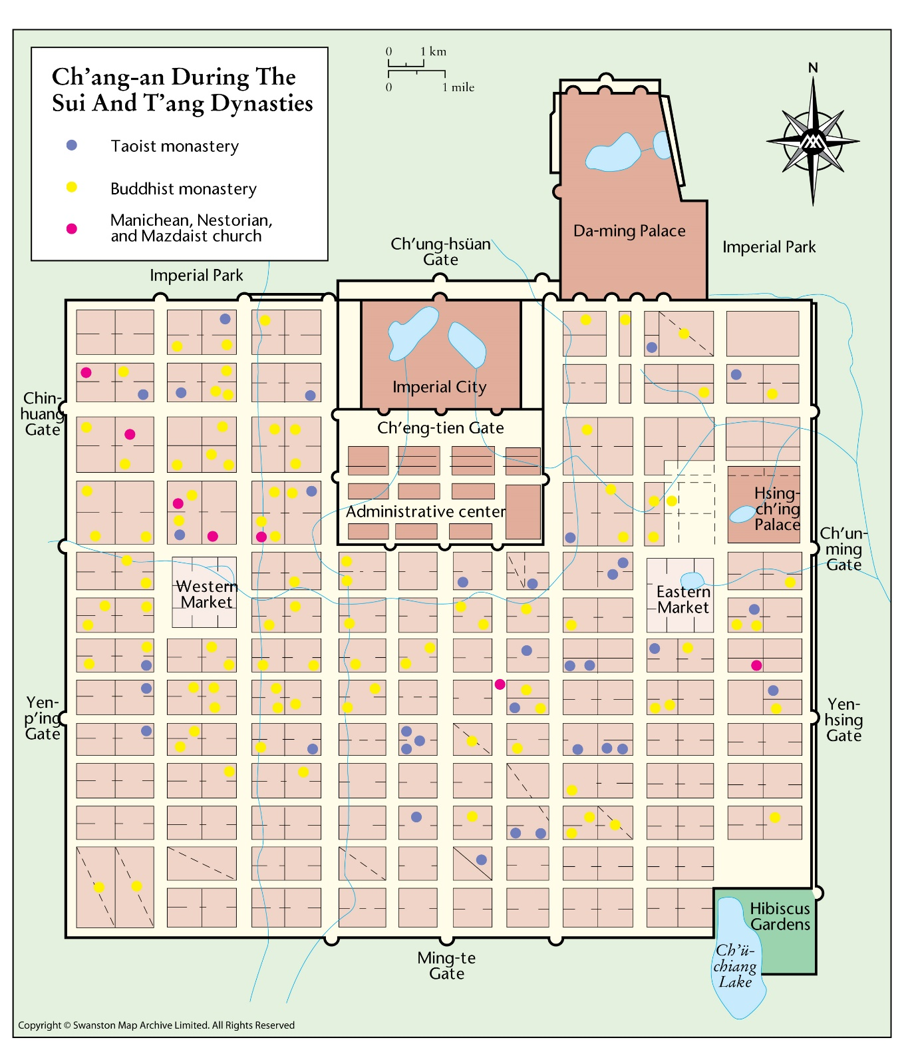
Largest Capital –
6 miles east-west
5 miles north-south
108 rectangular walled wards
2 million inhabitants

Slide 20
Walled Palace City
And
Government supervised Markets

Slide 21
Cosmopolitan – residents from Central Asia, Korea, Japan, Vietnam and Tibet

Slide 22
Religiously Diverse
Buddhism, Daoism, but also
Manichean
Nestorian
Zoroastrian

Slide 23
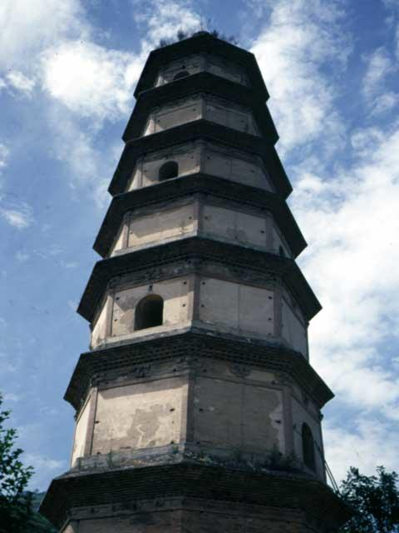
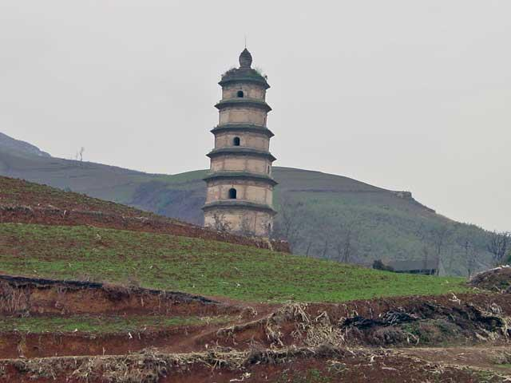
Da Qin Christian Pagoda
Notes:
https://www.wmf.org/project/da-qin-christian-pagoda-and-monastery
The earliest surviving church in China, the Da Qin Pagoda and Monastery were constructed at a time when Christianity was spreading to the east, introduced by the Nestorians in the early-seventh century A.D. Among the relics preserved within the pagoda are a nativity scene executed in mud and plaster; a statue depicting Jonah lying beneath the walls of Nineveh, which represents a fusion of Chinese and Western artistic traditions; and Syriac graffiti etched into the walls. The pagoda and monastery – only traces remain of the latter – were abandoned ca. 845 as a result of persecution.

Slide 24
Chinese Buddhism

Slide 25
The Flourishing of Buddhism
Buddhism flourished institutionally, intellectually, and artistically
Institutionally
Buddhist monasteries flourished economically
Operated mills and presses, banking functions
Large landowner
Provided medical care and lodging
Conduit of material cultures, e.g. chairs

Slide 26
The Flourishing of Buddhism
Institutionally
Aesthetically
Flowering of artistic production, sculpture, architecture, painting
Blended Indian style of corporality with Chinese style of linear rhythm.

Slide 27
The Flourishing of Buddhism
Institutionally
Aesthetically
Intellectually
Tendencies (schools) of thought develops into sectarian Buddhism
Sinicized; challenge to Confucian values neutralized
Sects were native to China and stressed a Chinese way of being religious

Slide 28
Opposition to Buddhism
Buddhism’s tax exempt status aggregated state’s fiscal problems
4,600 monasteries and 40,000 temples shut
260,000 monks and nuns defrocked
Buddhism remains important in Chinese life, but institutionally never fully recovered

Slide 29
Tiantai
Founded by monk Zhiyi (538-597) and named after his mountain headquarters
Promulgated Lotus Sutra

Slide 30
Lotus Sutra
Most popular Buddhist text in East Asia
Mahayana text
Lengthy
Apotheosis of the Buddha
Venerated as highest teaching of Buddha
Object of faith and worship
Soteriological: All can be enlightened by faith in the Buddha and Lotus Sutra

Slide 31
Tiantai
Tripartite Truth
The truth that all things are empty (shunyata or anatman)
The truth that they nevertheless have temporary existence
The truth that encompasses but transcends emptiness and temporariness
Truth is immanent in everything: all beings contain the Buddha nature and can be saved

Slide 32
Zhen Yen (Esoteric Buddhism)
Stressed magnificence and mystery of the Cosmic Buddha (Vairocana)
Use of secret symbolism and induction
Mantras
Mudras
Mandalas

Slide 33

Mantra Om Mani Padme Hum

Slide 34

Mudra
Notes:
https://senseofpurpose.org/resources/topic/well-being/mudra/
https://www.lotus-happiness.com/10-buddhist-mudras-meanings/
https://tricycle.org/magazine/mudra/

Slide 35
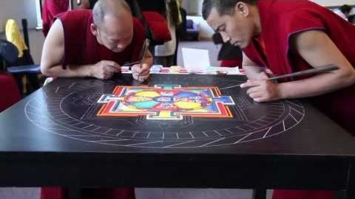
Tibetan Mandala
Notes:
https://youtu.be/IYVcjFhpsHc

Slide 36
Jingtu (Pure Land)
Three ages of Buddhism
Latter Day of the Law (Mappo)
Impossible to achieve enlightenment
Western Paradise presided over by Amitahba (Buddha of Infinite Light)
Invocation of the name of Buddha
Chant the nien-fo
Appealed to common man, became most popular form of Buddhism in East Asia

Slide 37
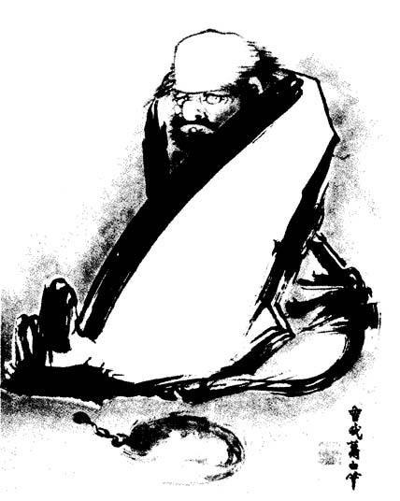
Chan (Zen)
Rejected authority of sutras (atextual)
Extolled mind-to-mind transmissions of Buddhist truths
First Patriarch – Bodhidharma
Meditation
Sudden enlightenment
Gong-an (Koan) inquiry
“if you meet the Buddha, kill him”
What is the Buddha? Three pounds of flax.

Slide 38
Mindfulness
Breathing Meditation
https://www.uclahealth.org/marc/mpeg/01_Breathing_Meditation.mp3

Slide 39
The Tang Elite

Slide 40
The Tang Elite
Elite families remain prominent despite wars and attacks on their prestige
Court orders genealogies conducted of prominent families
Demanded emphasis on current office holders
Banned intermarriage between 7 oldest families
Unintended consequence – upheld identify of elite
Notes:
Sui abolished nine-rank system; many families devastated by wars of the 6th century, resulted in deaths of 1000s of members of elite families.

Slide 41
The Tang Elite
Elite families remain prominent despite wars and attacks on their prestige
Court orders genealogies conducted of prominent families
Great families held disproportionate share of ministerial posts
Moved to capital
Education, manners, and family morality justify status
Judgments on calligraphy, speech, and deportment made it easy to exclude non-aristocrats
Notes:
Sui abolished nine-rank system; many families devastated by wars of the 6th century, resulted in deaths of 1000s of members of elite families.

Slide 42
Empress Wu

Slide 43
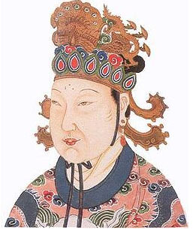
Wu Zhao - Rise to Power
Early Life
Born in 624 CE, Wu Zhao was raised in a well-off family with a focus on education.
At age 14, becomes concubine of Emperor Taizong (634 CE)
After Emperor Taizong's death, consorts and concubines are sent to Ganye Temple (Convent)
Escapes and returns to the palace

Slide 44
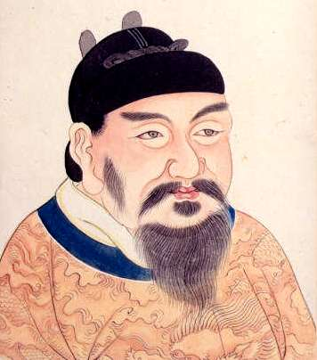
Succession Crisis
Crown Prince lost favor due to his infatuation with nomadic ways;
favorite son involved in court intrigue
Emperor Gaozong (Li Zhi)
Ultimately, succession went to Taizong's ninth son, Li Zhi, who became Emperor Gaozong.
Viewed by many as a weak and inexperienced choice, which contributed to the rise of Wu Zhao's influence in the court.
Notes:
Li Tai, the fourth son of Emperor Taizong, was involved in several court intrigues primarily aimed at discrediting his older brother, Crown Prince Li Chengqian. Li Tai sought to gain favor and potentially replace Chengqian as the heir. He actively undermined Chengqian by creating factions within the court, spreading rumors, and attempting to manipulate Taizong’s advisors to view his brother as incapable. This intense rivalry and political maneuvering ultimately destabilized the succession process, leading Emperor Taizong to remove both Li Chengqian and Li Tai from succession consideration. This left Li Zhi, a less politically entangled candidate, to become Emperor Gaozong.

Slide 45
Wu Zhao and Gaozong's Reign
Gaozong Marries Wu Zhao
Wu Zhao becomes Gaozong's first consort and eventually Empress in 655 CE.
660: Gaozong Suffers Health Crisis
Gaozong suffers a debilitating stroke, leading to Wu Zhao taking on the responsibilities of ruling.
Wu Zhao as De Facto Ruler
Wu Zhao assumes control of court affairs and effectively becomes the ruler.
She consolidates power by ordering the death or exile of opponents.
683: Death of Emperor Gaozong
After Gaozong's death, Wu Zhao's son, Li Zhe, ascends the throne as Emperor Zhongzong.
Empress Dowager Wu
Wu Zhao rules as Empress Dowager and Regent, exerting full control over the empire.

Slide 46
Empress Wu and the Zhou Dynasty
690 CE: Empress Wu Declares Herself Emperor
Empress Wu usurps the throne and declares the establishment of a new dynasty, the Zhou (690-705 CE).
Takes the Name Wu Zetian
She adopts the name Wu Zetian, symbolizing her role as the ruler of China.
Proclaimed Herself as the Incarnation of Maitreya
Wu Zetian promoted the idea that she was the incarnation of Maitreya, the future Buddha, to legitimize her rule.
Patron of Buddhism
Wu Zetian was a great patron of Buddhism, supporting the construction of temples and commissioning Buddhist texts, which helped enhance her religious legitimacy.
Notes:
Ordered temples set up in every province to expound the Dayunjing, a sutra propheizing the appearance of a female ruler. Patronage extends to other temples and sects; much of the work done at the Longmen caves was done under reign.

Slide 47
China’s Only Woman Emperor
Capable and Effective Ruler
Reign of Control and Repression
Expansion of Bureaucracy
Wu Zetian expanded the bureaucratic system and heavily promoted the use of the imperial examination system.
The examination system gradually became the primary means of acquiring official positions, promoting meritocracy.
Notes:
Wu Zetian demonstrated strong leadership skills and effectively consolidated power to stabilize her rule.
While known as a capable ruler, Wu Zetian also employed harsh measures, including a secret police force, to eliminate political rivals and maintain authority.
During the 690s, Wu Zetian was known to use extreme tactics to consolidate her power and eliminate threats. Historical sources indicate that a significant number of high-ranking officials, possibly around 36, were executed or coerced into committing suicide due to accusations of conspiracy or disloyalty. Furthermore, the punishment often extended to their families, who could be enslaved or otherwise severely penalized.
This approach was part of Wu Zetian's broader strategy to eliminate political opposition and maintain her authority, and it reflects the atmosphere of fear and control that characterized parts of her reign. However, some of these numbers might be exaggerated by her critics, as many historical accounts of Wu Zetian were written by later historians who had biases against her due to her unprecedented role as a female ruler.
Read more: http://blogs.smithsonianmag.com/history/2012/08/the-demonization-of-empress-wu/#ixzz2hF3RoeOj Follow us: @SmithsonianMag on Twitter

Slide 48
Bypassing Traditional Offices
Wu Zetian bypassed traditional officials and established close ties with a group of advisors known as the "Scholars of the Northern Gate."
Increased Status of Women
Tang women enjoyed greater freedoms under Wu Zetian, who served as a role model by breaking traditional gender barriers and supporting women's rights.

Slide 49
Tang Restoration and the End of Wu Zetian's Rule
Decline in Authority
In her later years, Empress Wu Zetian came under the influence of sycophantic courtiers and her control weakened.
705 CE: Palace Coup
A palace coup was carried out by officials, removing the 80-year-old Empress Wu from power.
Restoration of the Tang Dynasty
The Tang dynasty was restored, and Emperor Zhongzong, Wu Zetian's son, retook the throne.

Slide 50
Demonization of Wu Zhao
The Lord of Perfect Satisfaction!
Slut-Shaming
Slut-shaming involves attacking a woman’s sexuality to discredit her character or authority.
Often used to undermine women in power, especially when traditional avenues of criticism do not apply.
Notes:
https://www.smithsonianmag.com/history/the-demonization-of-empress-wu-20743091/

Slide 51
Slut-Shaming: Catherine the Great
Ruled Russia from 1762-1796; known for political, cultural, and intellectual achievements.
The Rumor: Persistent myth that Catherine died attempting to have sex with a horse.
Purpose of Rumor: To reduce her legacy to a sexually deviant figure; undermine her authority and accomplishments.

Slide 52
Slut-Shaming: Marie Antoinette
Queen of France leading up to the French Revolution.
The Libelles: Anonymous pamphlets targeting powerful figures, focusing on scandal and innuendo.
Portrayed as promiscuous; alleged extramarital affairs and incest with her son.
Contributed to her unpopularity and the narrative of moral corruption; damaged her public image.

Slide 53
Empress Wu Zetian and Confucian Backlash
Only woman to rule China as emperor during the Tang Dynasty (690-705 CE).
Confucian Ideals: Confucian scholars emphasized female virtues such as chastity, modesty, and obedience, viewing women as inherently subordinate; Wu Zetian's power was seen as an affront to their beliefs.
Narrative Against Her: Stories of sexual indulgence and promiscuity, including fabrications such as her supposed relationship with Xue Aocao and keeping numerous male lovers.
Confucian historians described her as manipulative, using seduction to rise in power, including alleged affairs with court officials and even monks.
The story of Xue Aocao: Wu Zetian supposedly summoned Xue, a man with prodigious physical attributes, for her personal pleasure. This sensationalized tale was used to paint her as an insatiable and morally corrupt ruler.

Slide 54
Empress Wu Zetian and Confucian Backlash
Further Accusations:
Affairs with Monks and Court Officials: Wu Zetian was accused of maintaining relationships with Buddhist monks and her court officials, which supposedly served both her political leverage and personal desires.
Poisoning of Rivals: She was depicted as using seduction to lure her rivals into vulnerable positions and then poisoning them to secure her power. This portrayal intended to show her as both dangerous and immoral.
Keeping Male Lovers as Emperor: After officially becoming emperor, Wu Zetian was accused of keeping numerous young male lovers in her court, depicted as distractions from her ruling duties.
Goal of Rumors: These accusations aimed to undermine her accomplishments by portraying her as morally corrupt and unfit for power. They justified the Confucian belief that women should not hold positions of authority.

Slide 55
Speaking Sex to Power
Sexuality as a Weapon: In each case, accusations focused on alleged deviant sexual behavior to reduce their legitimacy.
Fear of Female Authority: Powerful women stepping beyond traditional roles were targeted.
Impact on Legacy: Instead of their achievements, their reputations were often defined by scandal and innuendo.

Slide 56
Emperor Xuanzong
Grandson of Empress Wu, orchestrated a coup against Empress Wei,
Activist Emperor
Curbed power of monasteries to reduce their influence.
Ordered a new census to support the equal-field system, aiming to stabilize the taxation base.
Strengthened Confucian administrative practices.
Patron of Arts
Promoted cultural flourishing, including the works of poets like Li Bai and Du Fu.
Interest in both Buddhism and Daoism
Supported Daoist practices in court while maintaining favorable policies towards Buddhism.
Spent more time with favorite concubine Yang Guifei
An Lushan gained favor at court, partly due to his ties with Yang Guifei, which later influenced the outbreak of the An Lushan Rebellion.
Notes:
Grandson of Empress Wu Context:
The grandson mentioned is likely Emperor Xuanzong (also known as Li Longji). However, stating that he "slew Empress Wu" is inaccurate—she died of natural causes in 705 CE. Li Longji did, however, play a key role in a palace coup in 710 CE, overthrowing Empress Wei (Wu's granddaughter-in-law) to restore his father, Emperor Ruizong, to the throne.
Suggested Revision: "Grandson of Empress Wu, orchestrated a coup against Empress Wei, restoring his father, Emperor Ruizong, to the throne before abdicating in his favor."
Activist Emperor:
Curbed power of monasteries is accurate, as Emperor Xuanzong did try to reduce the influence of Buddhist institutions that had become economically powerful.
Ordered new census to support the equal-field system is also accurate, but it might benefit from more context. The equal-field system was crucial for maintaining land distribution and the taxation base.
Suggested Addition: Consider adding a point on Xuanzong's efforts to restore Confucian administration and centralize power, as this was key to his early reign.
Patron of the Arts:
This is accurate, as Xuanzong's court became a cultural hub, leading to a flourishing of poetry, music, and painting.
Suggested Addition: "Promoted cultural flourishing, including poetry by Li Bai and Du Fu."
Interest in Buddhism and Daoism:
It is accurate that Xuanzong was interested in both Buddhism and Daoism, balancing his spiritual interests to maintain harmony between different religious groups.
Suggested Addition: "Supported Daoist rituals and practices in court, while maintaining favorable policies towards Buddhist clergy."
Yang Guifei and An Lushan:
Yang Guifei’s favoritism is well noted, but the suggestion that she directly supported An Lushan is debated by historians. It is known that An Lushan, a trusted general, gained influence partly through his relationship with Yang Guifei.
Suggested Revision: "An Lushan gained favor at court, partly due to his ties with Yang Guifei, which later influenced the outbreak of the An Lushan Rebellion."
Revised Slide:
Grandson of Empress Wu, orchestrated a coup against Empress Wei, restoring his father, Emperor Ruizong, to the throne before abdicating in his favor.
Activist Emperor
Curbed power of monasteries to reduce their influence.
Ordered a new census to support the equal-field system, aiming to stabilize the taxation base.
Strengthened Confucian administrative practices.
Patron of Arts
Promoted cultural flourishing, including the works of poets like Li Bai and Du Fu.
Interest in both Buddhism and Daoism
Supported Daoist practices in court while maintaining favorable policies towards Buddhism.
Spent more time with favorite concubine Yang Guifei
An Lushan gained favor at court, partly due to his ties with Yang Guifei, which later influenced the outbreak of the An Lushan Rebellion.
These suggestions should help clarify the slide while providing a fuller picture of the complexities during Xuanzong's reign and the lead-up to the Tang Dynasty's later troubles. Let me know if you’d like more details on any of these points!
4o

Slide 57
High Tang
Reign of Xuanzong (r. 713-756) marks the high point of Tang Civilization, with the early years marked by prosperity and the later years by political instability.
Poetry and Painting Flourished
Horses as a popular theme in Tang art, symbolizing power and nobility.
Supported the expansion of the Imperial Music Academy, fostering a golden age of cultural development.
Political Achievements
Reformation of coinage to stabilize the economy.
Maintenance and extension of the Grand Canal for economic integration.
Improved land registration systems to support the equal-field system.
Power of Chief Ministers Increased
Emperor withdrew from daily governance in later years, focusing on personal interests.
Government administration was left to chief ministers, leading to a loss of central control.
Relationship with Yang Guifei allowed regional military figures like An Lushan to gain influence, setting the stage for rebellion.

Slide 58
Tang Dynasty Painting
Figure Painting Comes into Full Power
Focused on Emperors, ascetics, and court beauty, capturing their spirit and character.
Horses symbolized power and played a central role in Tang artistic themes.
Yan Liben, most celebrated artist during the reign of Taizong and Gaozong
Known for portraits of emperors and historical figures, including his famous work, "The Thirteen Emperors.
His style influenced the tradition of portrait painting in China, emphasizing formality and authority.
Han Gan
Specialized in painting horses, capturing their strength and vitality.
Famous for works like "Night-Shining White," showcasing his mastery of horse anatomy and spirit.

Slide 59
Tang Dynasty Poetry
Golden Age of Chinese Poetry (618–907 CE)
Tang Dynasty regarded as the pinnacle of classical Chinese poetry.
Over 50,000 poems composed by more than 2,000 poets.
Key Themes and Styles
Nature and Landscape: Reflections on the beauty and power of nature.
Reflections on Society: Poems about social life, political events, and the complexities of human emotions.
Personal Reflection and Nostalgia: Exploration of feelings like longing, exile, and the fleeting nature of life.
Famous Poets
Li Bai (李白): Known for his romantic and free-spirited style, capturing the grandeur of nature.
Du Fu (杜甫): Renowned for his realistic and somber portrayals of society and human suffering.
Wang Wei (王維): Celebrated for his meditative landscape poetry and blend of Buddhist philosophy.

Slide 60
The Rebellion of An Lushan and its Aftermath

Slide 61
Economic Challenges Leading to the Rebellion
Population Growth and its impact on the Equal-field System
Difficulties in redistributing land to peasant families
Rising tax burden on peasants, leading to economic hardship
Shift from corvée labor to paid professionals
Increased government expenses and use of mercenaries
Concerns about the loyalty of mercenaries to the Tang Dynasty

Slide 62
Devolution of Power: Rise of the Jiedushi
Rise of regional military governors (jiedushi)
Gained autonomy over civil and military affairs
Becoming nearly permanent officials in their territories
Loss of control by the Tang court over regional powers

Slide 63
An Lushan’s Rise and the Role of Yang Guifei
An Lushan’s Background: Half-Central Asian, half-Turkic soldier
An Lushan’s military control of three strategic regions
Influence of Yang Guifei (Emperor Xuanzong’s concubine)
Adopted as her legal son, increasing his influence at court
Tensions with Yang Guozhong, leading to conflict

Slide 64
Outbreak of the Rebellion (755 CE)
An Lushan’s rebellion against the Tang Dynasty
Commanded 100,000 troops, captured Luoyang
Advanced to Chang’an, forcing Emperor Xuanzong to flee
Execution of Yang Guifei by Xuanzong’s troops to placate discontent
Installation of Xuanzong’s son as the new emperor

Slide 65
The End of the Rebellion and Tang’s Victory
Death of An Lushan (757 CE) by assassination by his son
Triggered internal struggles among rebel leaders
Loyal Tang forces and Uyghur troops help restore Tang control
Restoration of Tang rule, but at a great cost

Slide 66
Consequences of the An Lushan Rebellion
Massive loss of life and economic devastation
Depopulation and decline in agricultural productivity
Exposure of fragility in Tang’s political and military structures
Rise of regional warlords, challenging Tang authority
Beginning of the Tang Dynasty’s long decline
Notes:
Despite the Tang's eventual victory, the An Lushan Rebellion inflicted irreversible damage on the empire. The war caused massive loss of life and economic devastation, leading to the depopulation of entire regions and a decline in agricultural productivity. The rebellion also revealed the underlying fragility of the Tang Dynasty’s political and military structures, leading to a diminished capacity for centralized control. The rise of regional warlords continued to threaten the stability of the Tang state in the years that followed, marking the beginning of the dynasty’s long decline.

Slide 67
Aftermath: Dependence on Foreign Troops
Reliance on Uyghurs for military support
Uyghurs’ role in reconquering Chang’an and Luoyang
Tang concessions to Uyghurs, leading to influence over the court
Loss of military autonomy and reduced influence beyond China proper
Notes:
In the wake of the An Lushan Rebellion, the Tang Dynasty became dependent on foreign troops for military support, particularly on the Uyghurs. The Uyghur Khaganate, a powerful nomadic empire in Central Asia, played a crucial role in helping the Tang reconquer lost territories, including the capitals Chang’an and Luoyang. In return, the Tang court was compelled to grant the Uyghurs substantial economic and political concessions. As a result, the Uyghurs gained significant influence over the Tang court, often dictating terms in exchange for military aid.
The Tang’s reliance on foreign troops underscored the empire’s loss of military autonomy and its inability to project power beyond China proper. Despite the Tang’s nominal control over the Silk Road regions, the Uyghurs effectively dominated Central Asia, exerting control over trade routes and strategic territories. The once-expansive Tang Empire was thus reduced to a shadow of its former self, with its influence limited to the core Chinese heartland.

Slide 68
Economic Reforms and the Double Tax System
Revival of monopolies in salt, tea, and liquor to stabilize revenue
Introduction of the Double Tax System (780 CE)
Taxes based on land area rather than individuals
Shifted burden to landowners, affecting state-local elite relations
Notes:
Economic Shifts: Revival of Monopolies and the Double Tax System
The economic strains of the An Lushan Rebellion necessitated significant changes in the Tang Dynasty’s fiscal policies. The rebellion and subsequent wars had devastated agricultural production, leading to a loss of tax revenue. In response, the Tang court revived old government monopolies, particularly in salt, tea, and liquor, to generate income. These monopolies became crucial sources of revenue, helping to stabilize the empire’s finances after the costly conflict.
Another major economic reform was the introduction of the Double Tax System in 780 CE. This new system consolidated various land, personal, and household taxes into a biannual levy based on land area rather than taxing individuals directly. By taxing landowners rather than peasants, the Double Tax System aimed to simplify tax collection and stabilize state revenues. However, it also shifted the burden of taxation onto landowners, which had long-term implications for the relationship between the state and local elites.

Slide 69
Rise of Eunuch Power in the Inner Court
Eunuchs’ control of the palace armies and imperial influence
Formation of self-perpetuating families through adoption
Example: Emperor Xianzong’s assassination by eunuchs
Sweet Dew Incident (835 CE): Failed plot to purge eunuchs
Resulted in the execution of over 1,000 officials by eunuchs
Notes:
Rise of Eunuch Power and the Inner Court
One of the most significant political changes in the aftermath of the An Lushan Rebellion was the rise of eunuch power within the Tang court. As the Tang emperors grew increasingly reliant on the inner court—comprised of eunuchs and personal attendants—traditional bureaucratic structures lost their influence. The eunuchs commanded the palace armies and acted as gatekeepers to the emperor, allowing them to shape decisions and appointments within the imperial court.
The rise of eunuchs led to the formation of self-perpetuating families through adoption, allowing them to entrench their power across generations. This dynamic made it difficult for the emperors to assert control over the court. For example, Emperor Xianzong (r. 805–820 CE), a ruler who attempted to reassert imperial authority, was murdered by eunuchs when his reforms threatened their power.
Efforts to curb eunuch influence were met with brutal retaliation. In 835 CE, when the emperor and scholar-officials attempted to purge the eunuchs during the Sweet Dew Incident, the plot was discovered. The eunuchs responded with a massacre, ordering the execution of over 1,000 officials and their families. This event solidified the eunuchs' dominance over the Tang court, ensuring that any opposition would be met with swift and deadly consequences.

Slide 70
Religious Changes: Taoism and Buddhist Persecution
Shift in favor of Taoism over Buddhism after the rebellion
Confiscation of Buddhist lands, defrocking monks, and release of slaves
Efforts to regulate the number of monks and monasteries
Broader effort to restore traditional values and reassert imperial control
Notes:
Changes in Religious Policy: Favoring Taoism and Persecuting Buddhism
In the aftermath of the rebellion, the Tang emperors shifted their religious policy in favor of Taoism, often at the expense of Buddhism. Buddhism, which had enjoyed imperial patronage and flourished during the early Tang, became a target of persecution as the dynasty sought to regain control over economic resources and assert its authority over religious institutions.
Imperial decrees led to the confiscation of Buddhist temple lands, the defrocking of monks, and the release of slaves and dependents associated with monastic estates. These measures were intended to diminish the economic power of the Buddhist church and redirect resources back to the state. The Tang court also instituted regulations to control the number of monks and monasteries, seeking to curtail the influence of Buddhism and reassert Confucian and Taoist values.
This shift in religious policy was partly driven by a desire to weaken institutions that had grown too powerful and autonomous, such as large Buddhist monasteries that controlled extensive lands and wealth. However, it also reflected the broader effort to restore traditional Chinese values and reassert imperial authority in the aftermath of the social and political upheaval caused by the rebellion.

Slide 71
Political Fragmentation and Factionalism
Rise of eunuchs led to factionalism among officials
Officials aligning with different factions for influence
Weakening of central authority and loss of political cohesion
Struggles between eunuchs, regional warlords, and scholar-officials
Notes:
Factionalism and the Fragmentation of the Court
The domination of eunuchs within the Tang court led to increasing factionalism among officials. Scholar-officials and military leaders often found themselves aligning with different eunuch factions to secure their positions and influence. This factionalism contributed to a divisive political atmosphere, where loyalty to the emperor was frequently secondary to allegiance to powerful eunuch factions.
The constant power struggles between eunuchs, regional warlords, and court officials further weakened the central government, making it difficult for the Tang emperors to maintain unity and effectively govern the empire. The lack of political cohesion and the erosion of the imperial authority meant that the Tang Dynasty never regained the centralized control it had enjoyed before the rebellion.

Slide 72
The Tang Dynasty’s Final Decades

Slide 73
Decline of Central Authority
The An Lushan Rebellion (755–763 CE) weakened the Tang Dynasty
Exposed vulnerabilities in political and military structures
Rise of regional military governors (jiedushi) with greater autonomy
Decentralization led to loss of control over territories
Notes:
Decline of Central Authority
The decline of the Tang Dynasty’s central authority began long before its official collapse in 907 CE. The An Lushan Rebellion (755–763 CE) was a pivotal turning point that weakened the Tang’s control over its territories. Although the rebellion was eventually suppressed, it caused immense loss of life and economic devastation, leaving large regions depopulated and agricultural production severely disrupted. The rebellion also exposed the underlying vulnerabilities in the Tang political and military structures, leading to a shift in power from the central government to regional military governors (jiedushi).
Following the An Lushan Rebellion, the jiedushi were granted greater autonomy, including control over local taxation and military forces. These governors, who were originally appointed to protect the frontiers, gradually became semi-independent rulers, only nominally loyal to the Tang emperor. The central court’s inability to rein in the jiedushi resulted in a de facto decentralization of power, with many regional leaders operating as warlords. This fragmented the political landscape of China and eroded the authority of the Tang court, making it increasingly difficult for the emperors to maintain unity.

Slide 74
Rise of Eunuch Power and Court Factionalism
Eunuchs gained influence over the emperor and court politics
Manipulated appointments and policy decisions
Led to factionalism and weakened central governance
Sweet Dew Incident (835 CE): failed attempt to curb eunuch power
Notes:
. Rise of Eunuch Power and Court Factionalism
The eunuchs played a significant role in the political dynamics of the Tang court, especially during the dynasty’s later years. Originally serving as palace attendants, the eunuchs gradually gained influence over the emperor and control of the palace armies. By the 9th century, they had become powerful intermediaries between the emperor and the civil administration, often manipulating appointments and policy decisions.
The rise of eunuch power led to factionalism within the court, as scholar-officials and military leaders were forced to align themselves with various eunuch factions to secure their positions. This power struggle weakened the central government, as decisions were made based on factional interests rather than the needs of the state. Efforts to curb the eunuchs’ power, such as the Sweet Dew Incident in 835 CE, failed disastrously. The eunuchs responded to the plot with a massacre, killing over 1,000 officials and further entrenching their dominance over the court.
This internal division and lack of a cohesive leadership made it difficult for the Tang Dynasty to respond effectively to the growing external threats and internal rebellions that emerged in the late 9th century.

Slide 75
Economic Hardships and Fiscal Instability
Natural disasters, corruption, and mismanagement weakened the economy
Frequent droughts and floods caused food shortages
The Double Tax System (780 CE) introduced to stabilize revenue
Shifted tax burden to landowners, deepening rural hardship
Notes:
Economic Hardships and Fiscal Instability
The economic foundation of the Tang Dynasty began to crumble in the 9th century. A combination of natural disasters, corruption, and mismanagement strained the empire’s resources. Frequent droughts and floods disrupted agricultural production, leading to food shortages and famines that left the population vulnerable and discontented. The economic impact of the An Lushan Rebellion further exacerbated the situation, as it had devastated large parts of the empire’s most fertile regions.
In response to the economic challenges, the Tang government attempted to reform its fiscal system, including the introduction of the Double Tax System in 780 CE. This system consolidated land and household taxes into a biannual levy based on land area rather than taxing individuals directly. While it initially helped stabilize state revenues, the Double Tax System also shifted the burden onto landowners, who often passed the costs onto peasants, deepening rural hardship.
As the government’s financial position weakened, so too did its ability to maintain infrastructure and pay for the loyalty of the jiedushi. The lack of funds further diminished the central government’s influence, as regional military governors began to assert more independence, collecting their own taxes and maintaining their own armies.

Slide 76
Internal Rebellions and Social Unrest
Widespread dissatisfaction with the Tang government's inability to provide
Huang Chao Rebellion (874–884 CE) further weakened the Tang
Rebellion devastated major cities like Guangzhou and Chang’an
Relied on regional warlords to suppress the revolt, increasing their power
Notes:
Internal Rebellions and Social Unrest
The later years of the Tang Dynasty were plagued by peasant uprisings and rebellions, reflecting widespread dissatisfaction with the government’s inability to address the suffering of the common people. One of the most significant of these revolts was the Huang Chao Rebellion (874–884 CE). Huang Chao, a salt merchant turned rebel leader, capitalized on the grievances of the peasantry and led a massive uprising against the Tang government.
The Huang Chao Rebellion swept across much of central and southern China, sacking major cities including Guangzhou and the imperial capital Chang’an. Although the rebellion was eventually suppressed with the help of regional warlords, it dealt a devastating blow to the Tang Dynasty, causing further destruction and displacement. The rebellion left the Tang court even more reliant on the military governors, who emerged from the conflict with even greater power and autonomy.
The social upheaval caused by these uprisings highlighted the growing disconnect between the Tang court and the local populations. The inability of the central government to address the needs of the people and maintain order further eroded the legitimacy of the Tang emperors, making it increasingly difficult to hold the empire together.

Slide 77
The Fall of the Tang Dynasty and the Rise of Regional Powers
Tang Dynasty reduced to a symbolic presence in Chang’an
Regional warlords dominated territories and fought for control
In 907 CE, Zhu Wen deposed the last Tang emperor, Emperor Ai
Marked the beginning of the Five Dynasties and Ten Kingdoms period
Notes:
The Fall of the Tang Dynasty and the Rise of Regional Powers
By the early 10th century, the Tang Dynasty had been reduced to little more than a symbolic presence in Chang’an, with real power resting in the hands of the regional warlords. These warlords, who controlled their own territories and armies, often fought amongst themselves for dominance, leading to a period of fragmentation known as the Five Dynasties and Ten Kingdoms (907–979 CE).
In 907 CE, Zhu Wen, a former rebel who had risen to power as a military governor, deposed the last Tang emperor, Emperor Ai, and declared himself the ruler of the Later Liang Dynasty. This officially ended the Tang Dynasty and marked the beginning of a new era of division and regional rule in China.
The collapse of the Tang Dynasty did not happen suddenly; it was the culmination of decades of internal decay, economic hardship, political fragmentation, and social unrest. The inability of the central government to maintain control over its territories, coupled with the rise of regional powers and the decline of imperial authority, ultimately led to the end of one of China’s greatest dynasties.

